Slide 1
Flexibility of regulations and difficulties of prediction
SES performance regulation:
Provides for preparation of a performance plan, which has to adequately contribute to the achievement of 3 non-financial KPIs and 1 financial KPI
Comprises fixed macro framework (DC, traffic scenario, inflation by IMF). These parameters are difficult to be precisely forecasted

Slide 2
Flexibility of regulations and difficulties of prediction
Regulation 2019/317 provides for certain flexibility, stemming from:
TRS, CRS, inflation adjustments
Note 1: Inflation and traffic scenario might be impacted by events which are far away from local airspace and out of State/ANSP control
B) Local circumstances – could be used to justify certain deviations
Note 2: Whatever the regulation, it should be compatible with economic theory!

Slide 3
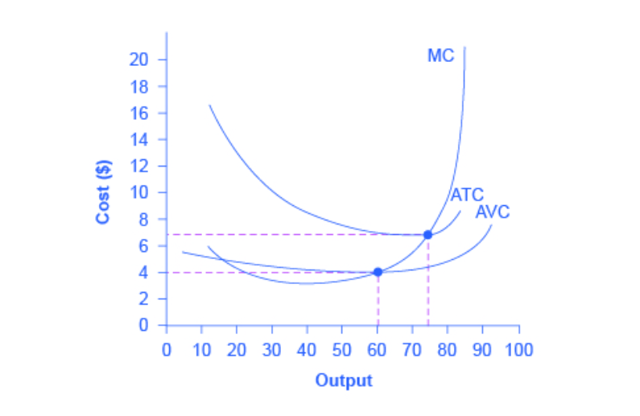
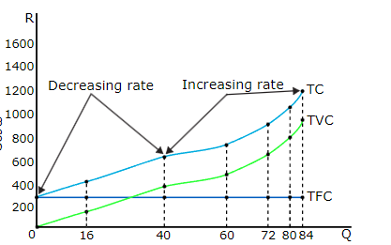
Cost curves - Microeconomics
Total costs (Fixed costs could be the same over 1 year, but may vary with Q over the years) TC = TFC + TVC
AC and MC (MC start growing because of diminishing marginal returns)

Slide 4
Revenue curves – normal and regulated

Slide 5
Flexibility of regulations and difficulties of prediction
Potential conflict between regulation and economic theory:
Demand is exogenous, ANSPs “have to” meet it. If delta in demand is cumulatively significantly above the forecast, this might lead to a situation, where
Additional costs to meet demand > Additional revenue from ANS
There is money in the system, but ANSPs are not allowed to spend it
This could result in lack of financing for the accrual of sufficient resources to meet non-financial targets [unless the performance plan is revised, which is a time-consuming exercise]

Slide 6
Flexibility of regulations and difficulties of prediction
Conclusions:
ANSPs could often operate in a situation which is contradictory to economic theory due to limited flexibility of the regulatory framework
Interdependencies between all 4 KPIs need to be elaborated clearly in order to give a meaningful way forward for regulatory amendments while improving performance.

